Slide 1
LECTURE NOTE CHEM 3302 Inorganic Chemistry By Dr. Mrs. Bertha Abdu Danja Department of Chemical Sciences, Faculty of Science Federal University Kashere , Gombe State Nigeria First Semester 2017/2018

Slide 2
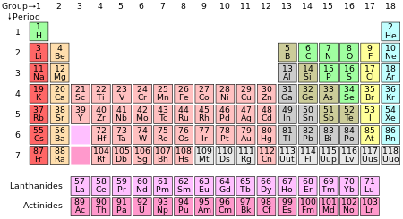
Periodic Table

Slide 3
Hydrogen Preparation, Properties and Reactions
Background:
Hydrogen is found in group one, period one in the periodic table.
It has a simple atomic structure
Is the most abundant element in the universe
The stable form is dihydrogen i.e. H₂
It is found in oceans, minerals and all forms of life
It also occurs naturally as a product of fermentation and a byproduct of ammonia synthesis
Ground State configuration is 1s¹
It has a richly varied chemical properties
Is a strong lewis base (H⁻) and a strong Lewis Acid (H⁺)
It bonds with nearly every other element

Slide 4
Properties of Hydrogen
) Its Ionization energy is far higher than those of the other Group 1 elements
Is not a metal
Electron Affinity of hydrogen is far lower than that of any of the elements of Group 7
The intermolecular forces between H₂ molecules are week, at 1atm the gas condenses to a liquid only when cooled to 20k
H2 molecule has a high bond enthalpy (436KJmol⁻¹)
It has a short bond length (7pm)
It has a high bond strength so that the H₂ is an inert molecule, as such reactions of H₂ does not occur readily
Hydrogen is an excellent fuel for large rockets on account of its high specific enthalpy (Standard enthalpy of combustion divided by the mass)

Slide 5
Properties of Hydrogen
Hydrogen can gain an electron in a chemical reaction to achieve a noble gas configuration, i.e. Hydride ion, H⁻ which is a powerful reducing agent
Hydrides may act as ligands in bonding to metals e.g. ReH₉²⁻
Bonding to hydrogen atoms is essentially covalent
Hydrogen ion (H⁺) is common, but in aqueous solution, a more correct description is H₃O⁺ (aq)
Molecular hydrogen is also an important reagent in the industrial hydrogenation of unsaturated organic molecules
Hydrogen has three isotopes, i.e. Protium, (Normal hydrogen H) Deuterium ( Heavy hydrogen D) and Tritium ( Another heavy form T)

Slide 6
Table 1 Properties of Hydrogen
Isotope | Abundance (%) | Atomic Mass | Melting Point (K) | Boiling Point (K) | Critical Temperature (K)ª | Enthapy of Dissociation(KJ mol⁻¹ at 25^{oc})
Protium (¹H), H | 99.985 | 1.007825 | 13.957 | 20.30 | 33.19 | 435.88
Deuterium (²H), D | 0.015 | 2.014102 | 18.73 | 23.67 | 38.35 | 443.35
Tritium (³H), T | ≈ 10⁻¹⁶ | 3.016049 | 20.62 | 25.04 | 40.6 | 446.9

Slide 7
Preparation of Hydrogen
Industrially, most H2 is produced from natural gas by using steam reforming ( the catalyzed reaction of H2O As Steam and hydrocarbons typically methane from natural gas
It is also produced industrially by other methods such as coal gasification and thermally assisted electrolysis
At a small scale it can be produced from the laboratory from electropositive elements and mineral acids or by hydrolysis of saline hydrides, or by electrolysis

Slide 8
Preparation of Hydrogen by Electrolysis
Electrolytic hydrogen is the purest commercially available grade of hydrogen and is made by the electrolysis of water.
2H₂O ==> 2 H₂(g) + O₂(g
nickel electrodes are used with warm saturated barium hydroxide solution.
The prepared gas is passed over hot platinum gauze to purify it
The gas is then dried by passing it over potassium hydroxide pellets and pure redistilled powdered phosphorus pentoxide.

Slide 9
Preparation of Hydrogen by the Action of Metals
The alkali metals, lithium, sodium, and potassium react violently with water at the ordinary temperature, yielding hydrogen.
2Li + 2 H₂O ==> H₂ + 2 LiOH
Calcium reacts with water more slowly unless the water is hot, when the action is more vigorous
Ca + 2 H₂O ==> H₂ + Ca(OH)₂

Slide 10
Preparation of Hydrogen by Decomposition of Water
Cold water is decomposed by amalgamated aluminium (i.e. an alloy of aluminium and mercury which is made by rubbing aluminium foil with damp mercuric chloride).
2 Al + 6 H₂O ==> 2 Al(OH)₃ + 3 H₂
Hot water is decomposed by zinc-Copper couple (i.e. solid granules of zinc covered by a surface layer of copper which made by pouring a solution of copper sulphate over granulated zinc).
Zn + 2H₂O ==> Zn(OH)₂ + H₂

Slide 11
Preparation of Hydrogen by Decomposition of Water
Boiling water is slowly decomposed by magnesium power.
Mg + 2H2O ==> Mg(OH)2 + H2
Steam is decomposed when passed over heated magnesium, zinc, and iron.
Mg + H2O ==> MgO + H2
Zn + H2O ==> ZnO + H2
3 Fe + H2O <==> Fe3O4 + 4H2
The last reaction, (i.e. the action of iron on steam) is reversible, depending on the experimental conditions.

Slide 12
Preparation of Hydrogen from Action of Acids
Hydrogen is prepared in the laboratory by the action of acids on metals. Dilute sulphuric acid containing 1 volume of concentrated acid to 5 volumes of water, or dilute hydrochloric acid containing 1 volume of concentrated acid to 4 volumes of water, is added to granulated zinc. Zinc sulphate or zinc chloride is formed in solution and the hydrogen that is evolved is collected over water in a trough.
Zn + H2SO4 ==> ZnSO4 + H2
Zn + 2 HCl ==> ZnCl2 + H2
Since hydrogen is very much lighter than air it may also be collected by upward displacement.

Slide 13
Industrial Manufacture of Hydrogen
Pure hydrogen is manufactured industrially by the steam reforming of natural gas, and by the electrolysis Of water.
The manufacture of hydrogen on an industrial scale involves the reaction between steam and iron. Spongy iron from the reduction of spathic iron ore (ferrous carbonate) is heated to redness and steam passed over it.
3 Fe + 4 H2O ==> Fe3O4 + 4 H2
The hot ferrosoferric oxide, Fe3O4, is then reduced with water gas:
Fe2O4 + 4 H2 ==> 3 Fe + 4 H2O
Fe2O4 + 4CO ==> 3 Fe + 4 CO2 Water gas is made by passing steam over red hot carbon and it consists of a mixture of carbon monoxide and hydrogen, with a smaller amount of carbon dioxide:

Slide 14
Industrial Manufacture of Hydrogen
Commercially Hydrogen can be prepared by cracking petroleum hydrocarbons with solid catalysts
C₂H₆ ==> C₂H₄ + H₂
Also can be prepared by steam reforming of natural gas using catalyst
CH₄ + H₂O ==> CO + 3H₂

Slide 15
Reactions of Hydrogen
Hydrogen is quite stable that it is an inert molecule, but it reacts very rapidly under special conditions such as:-
A) Homolytic dissociation into H atoms using metal surfaces
H2 + Pt ==> Pt-H (adsorption of H ions on Pt surfaces)
B) heterolytic dissociation into H+ and H- ( metal ion for coordination)
H2 + Zn-O-Zn-O- ==> metal coordinated ions
C) Initiation of a radical chain reaction
H2 x ==>XH. + H. O2==> HOO.
e.g Initiation by heat or light Br2 ==> Br. + Br.
Propagation Br. + H2 ==> HBr + H.
Termination H. + H. ==> H2
Br. + Br. ==> Br2
H. + Br. ==> BrH

Slide 16
Introduction to the s block elements - Group 1 Alkali Metals and Group 2 Alkaline Earth Metals
Gp1
₁H
₃Li
lithium
₁₁Na
sodium
₁₉K
potassium
₃₇Rb
rubidium
₅₅Cs
caesium
₈₇Fr
francium

Slide 17
Introduction to the s block elements - Group 1 Alkali Metals and Group 2 Alkaline Earth Metals
Gp2
₄Be
beryllium
₁₂Mg
magnesium
₂₀Ca
calcium
₃₈Sr
strontium
₅₆Ba
barium
₈₈Ra
radium
outer electrons: Group 1 ns¹ and Group 2 ns²

Slide 18
Introduction to the s block elements - Group 1 Alkali Metals and Group 2 Alkaline Earth Metals
The first two vertical columns of the Periodic Table, i.e. Groups 1 and 2, are called the s–block metals, because they only have 1 or 2 electrons in their outer shell.
These outer electrons are of an s–orbital type (s sub–shell or sub–quantum level) and the chemistry of the metals, with their relatively low ionisation energies, is dominated by the loss of these s electrons to form a cation and also accounts for their generally high chemical reactivity

Slide 19
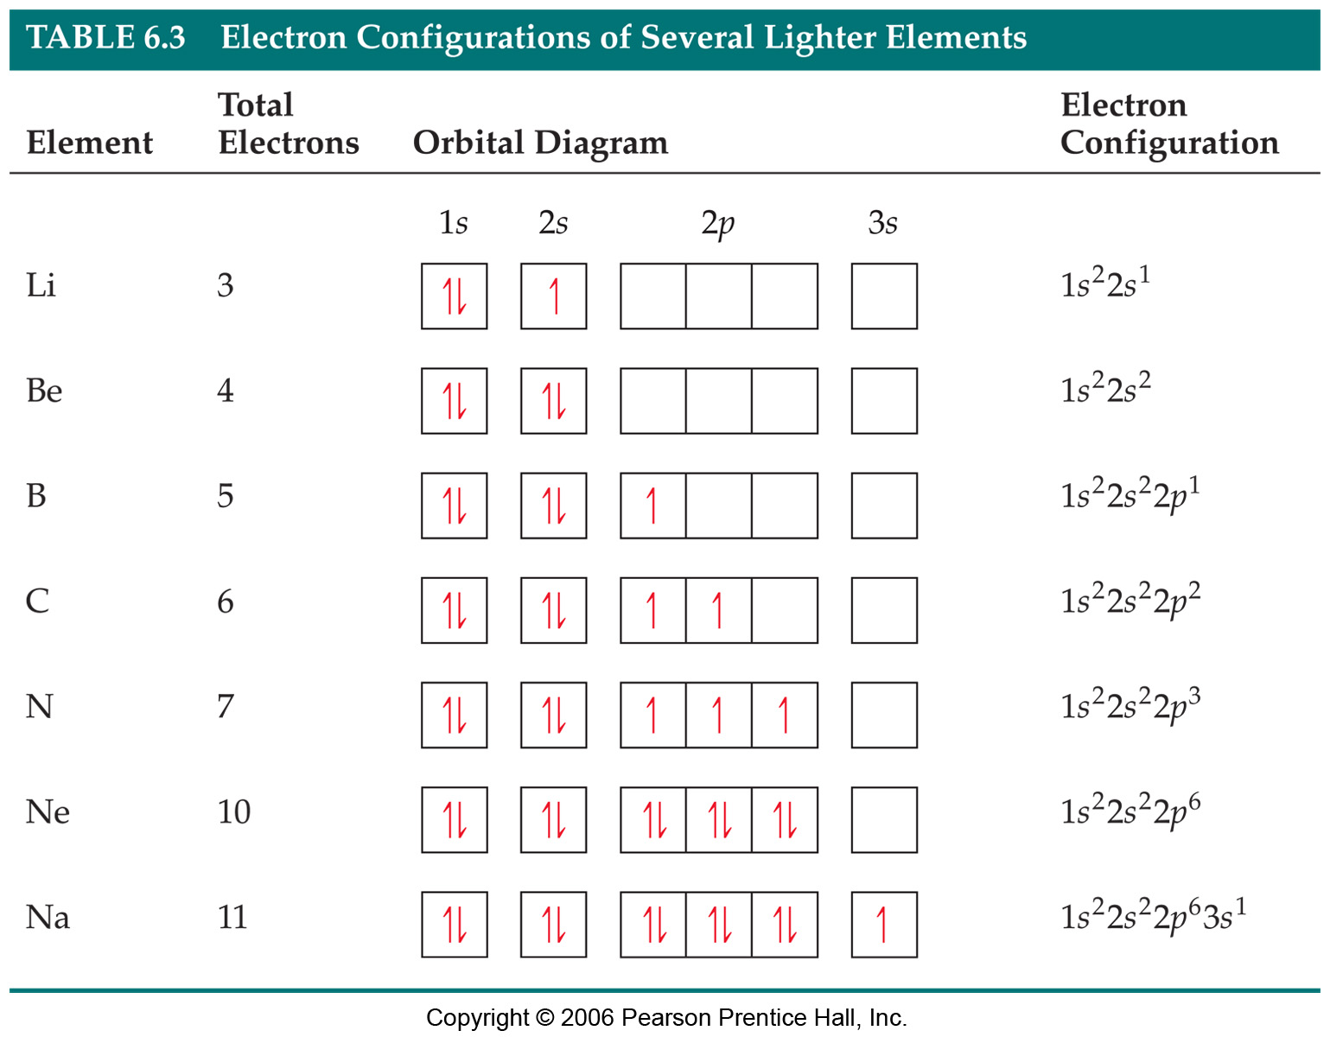
Electronic Structure of atoms

Slide 20
Electronic Structures of 1A
H has its only electron in the 1s orbital - 1s¹,
Li has an electronic structure of 1s²2s¹.
Na has an electronic structure of 1s²2s²2p⁶3s¹
K has an electronic structure of 1s²2s²2p⁶3s²3p⁶4s¹
Rb has an electronic structure of 1s²2s²2p⁶3s²3p⁶4s² 3d¹⁰ 4p⁶5s¹
Cs 1s², 2s²2p⁶, 3s² 3p⁶, 4S² 3d¹⁰ 4P⁶, 5s² 4d¹⁰ 5p⁶, 6s¹
Fr 1S2, 2S2 2P6, 3S23P6, 4S23d10 4P6, 5S2 4d10 5P6, 6S2 4f14 5d10 6p6, 7S1

Slide 21
Group Ia and Group IIa
The outer s¹ electron loss by the Group 1 Alkali Metals gives the M⁺ ion, and,
The outer s² electrons lost by the Group 2 Alkaline Earth Metals forms the M²⁺ ion,
And in each case the cation has a residual very stable noble gas core of electrons.

Slide 22
Group Ia and Group IIa
The only chemically stable oxidation states are +1 for Group 1 metals and +2 for Group 2 elements,
This is because of the ease of loss of the outer S electrons and the difficulty in removing the next one due to high ionisation energies required
The relative ease of delocalising the outer 1/2 electrons in the metal lattice makes them good conductors of heat and electricity
The low ionisation energies and low electronegativity means that when combined with non–metals, most compounds of the Group 1–2 elements tend to be ionic in nature.

Slide 23
Group Ia and Group Ia
Properties\Name | Lithium | Sodium | Potassium | Rubidium | Caesium | Francium
melting point/ºC | 181 | 98 | 64 | 39 | 29 | 27
boiling point/ºC | 1347 | 883 | 774 | 688 | 679 | 677
density/gcm^{–3} | 0.53 | 0.97 | 0.86 | 1.48 | 1.87 | > 1.87
1st IE/kJmol^{–1} | 513 | 496 | 419 | 403 | 376 | 400
2nd IE/kJmol^{–1} | 7298 | 4562 | 3051 | 2632 | 2420 | 2100
atomic metallic radius/pm | 152 | 186 | 231 | 244 | 262 | 270
M⁺ ionic radius/pm | 78 | 98 | 133 | 149 | 165 | 180
Electronegativity | 0.98 | 0.93 | 0.82 | 0.82 | 0.79 | 0.70

Slide 24
Group Ia and IIa
Elements/properties | Li | Na | K | Rb | Cs | Fr
Electrode potential M/M⁺ | -3.04v | -2.71v | -2.92v | -2.92v | -2.92v | -2.92v
electron configuration | 2,1 | 2,8,1 | 2,8,8,1 | 2,8,18,8,1 | 2,8,18,18,8,1 | 2,8,18,32,18,8,1
Electron Configuration | (He) 2s1 | (Ne)3s1 | (Ar)4s1 | (Kr)5s1 | (Xe)6s1 | (Rn)7s1

Slide 25
Group Ia and IIa
Typical metals in some ways e.g. silvery grey lustrous solids, very good conductors of heat and electricity, relatively high boiling points.
When freshly cut they are quite shiny, but they rapidly tarnish by reaction with oxygen to form an oxide layer, which is why they are stored under oil
The 1st ionisation energies are the lowest of any group of elements, but note the jump up to a very high 2nd ionisation energy.

Slide 26
Group Ia and IIa
The very high 2nd ionization energy is due to removing an electron from an electronically very stable noble gas inner core of electrons
Group IIa are typical metals, silvery grey lustrous solids, relatively high melting and boiling points, good conductors of heat and electricity.
The first two ionisation energies are relatively low but there is quite a jump to the 3rd ionisation energy
The very high 3rd ionization energy is due to removing an electron from an electronically very stable noble gas inner core of electrons

Slide 27
Group IIa
Compared to adjacent Group 1 metal on same period:
The melting and boiling points are higher, and they are harder, stronger and more dense than the adjacent Group 1 metal on the same period. This is because their are two delocalised electrons per ion in the crystal lattice giving an overall stronger electrical attraction with the more highly charged M²⁺ ions.
Chemically very similar e.g. form mainly ionic compounds but different formulae and less reactive because the 1st ionisation energies are higher (due to extra nuclear charge) and a 2nd ionisation energy input to form the stable M²⁺ ion.
Oxidation state or oxidation number is always +2 in Group 2

Slide 28
Group IIa
The two outer s–electrons are readily lost. The 3rd, and subsequent ionisation energies are far too high to form chemically stable cations of 3+ etc. i.e. the energy required will not be compensated by ionic bond formation.
The stable Group 2 cation has electron configuration of noble gas,
e.g. the calcium atom, Ca, is 2,8,8,2 or 1s²2s²2p⁶3s²3p⁶4s² or [Ar]4s²
so the calcium ion, Ca²⁺, is 2,8,8 or 1s²2s²2p⁶3s²3p⁶ or [Ar]

Slide 29
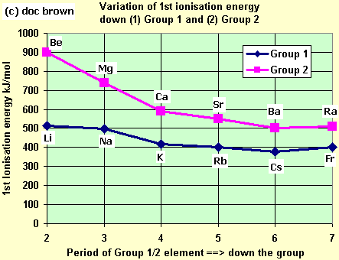
General Trends down groups 1 & 2 with increasing atomic number and formula patterns
The 1st ionisation energy (IE) or 2nd etc. decrease: (important to link to reactivity trend)

Slide 30
Group IIa
REACTIVITY TREND THEORY – relate to atomic radius and ionisation energy
The metal gets more reactive down the group because ...
When an alkali metal atom reacts, it loses an electron to form a singly positively charged ion e.g. Na ==> Na⁺ + e–
As you go down the group from one element down to the next the atomic radius gets bigger due to an extra filled electron shell.
The outer electron is further and further from the nucleus and is also shielded by the extra full electron shell of negative charge.
Therefore the outer electron is less and less strongly held by the positive nucleus.
This combination of factors means the outer electron is more easily lost, the M⁺ ion more easily formed, and so the element is more reactive as you go down the group
The reactivity argument mainly comes down to increasingly lower ionisation energy down the group and a similar argument applies to the Gp 2 metals, but two electrons are removed to form the cation.
The reaction of a group 1/2 metal with oxygen, water or halogens gets more vigorous as you descend the group.

Slide 31
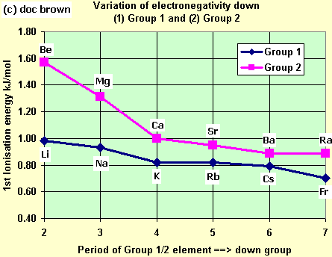
Group I a and IIa
The Electronegativity tends to decrease:

Slide 32
Group Ia and IIa
The electronegativity values are the lowest in the last element down the group
They get lower because the effective nuclear attractive force on the outer electron charge decreases down the group.
You can explain it along the lines of the decreasing 1st IE argument , that means weaker attraction of electron charge'

Slide 33
Group IIIa
There are five chemical elements in group IIIA of the periodic table:
These are:- Boron B, Aluminum Al, Gallium Ga, Indium In and Thallium Tl.

Slide 34
Group IIIa
The atoms of these elements have the following configurations:
₅B–1s²2s²2p¹ [He]2s²2p¹
₁₃Al–1s²2s²2p⁶3s²3p¹ [Ne]3s²3p¹
₃₁Ga–1s²2s²2p⁶3s²3p⁶3d¹⁰4s²4p¹ [Ar] 4s²4p¹
₄₉In–1s²2s²2p⁶3s²3p⁶3d¹⁰4s²4p⁶4d¹⁰5s²5p¹ [Kr] 5s²5p¹
₈₁Tl–1s²2s²2p⁶3s²3p⁶3d¹⁰4s²4p⁶4d¹⁰4f¹⁴5s²5p⁶5d¹⁰6s²6p¹ [Xe]6s²6p¹

Slide 35
Group IIIa: Group Trend
Metallic character increases down the group
The first member of the group boron, is essentially nonmetallic, whereas the properties of members of the group are distinctly metallic
The elements have variation from predominantly covalent to ionic bonding in their compounds
Atomic radius increase down the group
Ionization energy decreases down the group
The valence electron configuration is ns² np¹
They have +3 oxidation state in their compounds but heavier members also use +1 oxidation state in their compounds e.g. Tl, +1 0xidation state becomes more stable down the group

Slide 36
Properties of the Group IIIa Elements
Properties | Boron | Aluminum | Gallium | Indium | Thallium
Melting point, °C | 2076 | 660 | 30 | 157 | 304
Boiling point, °C | 3927 | 2519 | 2204 | 2072 | 1473
Density, g/cm³ | 2.46 | 2.7 | 5.9 | 7.3 | 11.85
Electronegativity | 2.0 | 1.6 | 1.8 | 1.7 | 1.6
Covalent radius, Å | 0.91 | 1.43 | 1.39 | 1.66 | 1.71
Ionic radius, Å | 0.20 | 0.57 | 0.62 | 0.92 | 1.05

Slide 37
Chemistry of Boron and its compounds
Boron is the first element in group III
In many of its properties it differs from the next element in the group, aluminum, which is a metal
It is a very poor conductor of electricity therefore it is best regarded as a semimetal, like silicon than metallic
Boron shows trivalency in its compounds

Slide 38
Chemistry of Boron and its compounds
It is difficult to get B³⁺ , therefore, boron forms tricovalent compounds
Boron shows common oxidation state of +3 in majority of its compounds
However boron shows also an oxidation state of –3 in the metal borides, e.g., in Mg₃B₂
Boron forms oxide B₂O₃ when heated in oxygen atmosphere at high temperature:
4B + 3O₂ ==> 2B₂O₃ (Boron oxide or Boric anhydride).

Slide 39
Chemistry of Boron and its Compounds
Boron can form trichloride either by passing chlorine over the heated boron or by passing chlorine over the heated mixture of its oxide and charcoal
2B + 3Cl₂ ==> 2BCl₃;
B₂O₃ + 3C + 3Cl₂ ==> 2BCl₃ + 3CO.
BCl₃ is hydrolyzed by water:
BCl₃ + 3H₂O → H₃BO₃ + 3HCl.

Slide 40
Chemistry of Boron and its Compounds
Boron forms nitride BN when heated in the atmosphere of nitrogen or ammonia and sulfide B₂S₃ when heated with sulfur:
2B + N₂ ==> 2BN;
2B + 2NH₃ ==> 2BN + 3H₂;
2B + 3S ==> B₂S₃
The nitride and sulfide of Boron undergo hydrolysis with steam to form Boric acid
BN + 3H₂O → H₃BO₃ + NH₃;
Boric acid
B₂S₃ + 6H₂O → 2H₃BO₃ + 3H₂S.

Slide 41
Chemical Properties of Boron and its Compounds
Boron reacts with steam when heated liberating hydrogen:
2B + 3H₂O → B₂O₃ + 3H₂.
Its also react with H₂SO₄ and evolves sulfur dioxide, SO₂:
2B + 3H₂SO₄(conc.) → 2H₃BO₃ + 3SO₂↑.
It can also dissolve in alkalies and evolve hydrogen
2B + 6NaOH → 2Na₃BO₃ + 3H₂↑.
Producing sodium orthoborate
Boron acts as powerful reducing agent:
4B + 3CO₂ → 2B₂O₃ + 3C;
4B + 3SiO₂ → 2B₂O₃ + 3Si.

Slide 42
Compounds of Boron
BORANES: Compounds of Hydrogen and Boron are known as Boranes e.g. B₂H₆, B₄H₁₀, B₅H₉, and B₁₀H₁₄
Their formulas are not what we expect like +3 oxidation state of Boron

Slide 43
Boranes
The unusual and unexpected feature of this structure is that there are two hydrogen atoms, calledbridging hydrogens, shared between the two borons. However, there are not enough electrons for each of the lines shown in the structure to represent an electron pair. Each atom of boron contributes 3 electrons and each atom of hydrogen 1 electron, making a total of 12 electrons, or six pairs for the molecule. Thus there can be a maximum of only six ordinary covalent bonds, whereas the structure appears to have eight bonds. Because B₂H₆ has too few electrons for all the atoms to be held together by normal electron pair bonds between two nuclei, it is often described as an electron-deficient molecule. The bonding in diborane is best described as involving two three-center bonds, in which one electron pair holds together three rather than two nuclei. Each boron atom is surrounded by four electron pairs, which have the expected tetrahedral arrange­ment. But two of these electron pairs form three-center bonds in which one electron pair holds together two boron nuclei and a hydrogen nucleus

Slide 44
BORON HALIDES
The boron halides are typical covalent nonmetal halides
Boron trifluoride, BF₃, and boron trichloride, BCl₃, are gases at room temperature;
BBr₃ is a liquid, and BI₃ is a solid
These halides all consist of molecules with the expected AX₃ planar triangular structure
Although the electronegativity difference between boron and fluorine is 2.1, boron trifluoride is a covalent molecular compound with polar B–F bonds rather than an ionic crystal containing B³⁺ and F– ions

Slide 45
Boron Halides
Because of the presence of the vacant 2p orbital on the boron atom in the boron halides, they are rather reactive compounds
For example, BF₃ reacts with an F– ion to form BF^{4–} in which the valence shell of boron is completed
BF₃ + NaF → NaBF₄
The boron halides react with water forming boric acid and the hydrogen halides. For example,
BCl₃ + 3H₂O → H₃BO₃ + 3HCl

Slide 46
BORIC ACID AND BORATES
Boric acid and the borates are among the simplest and most important of the boron compounds. Boric acid, B(OH)₃, is a stable, colorless crystalline compound that forms thin, plate like crystals. It consists of planar molecules with an equilateral triangular AHal₃ geometry around boron. The molecules are held together in flat sheets by hydrogen bonds:

Slide 47
BORIC ACID AND BORATES

Slide 48
BORIC ACID AND BORATES
Boric acid is a very weak monoprotic acid (K_{a} = 6.0´10^{–10}). It ionizes in water in an unusual way. Instead of donating one of its hydrogen atoms to a water molecule; it removes an OH⁻ from a water molecule, leaving an H⁺ ion, which combines with another water molecule to give an H₃O⁺ ion:
H₃BO₃ + 2H₂O → B(OH)₄– + H₃O⁺ .

Slide 49
Group IVa
Group elements are Atomic Number
Carbon ( C ) 6
Silicon ( Si ) 14
Germanium ( Ge ) 32
Tin ( Sn ) 50
Lead ( Pb ) 82
Very diverse in chemical and physical properties e.g. C nonmetallic, while Sn and Pb are metals. These elements in this group are very important in nature

Slide 50
Group IVa
The atoms of these elements have the following configurations:
₆C –1s²2s²2p² [He]2s²2p²
₁₄Si–1s²2s²2p⁶3s²3p² [Ne]3s²3p²
₃₂Ge–1s²2s²2p⁶3s²3p⁶3d¹⁰4s²4p² [Ar] 4s²4p²
₅₀Sn–1s²2s²2p⁶3s²3p⁶3d¹⁰4s²4p⁶4d¹⁰5s²5p² [Kr] 5s²5p²
₈₂Pb–1s²2s²2p⁶3s²3p⁶3d¹⁰4s²4p⁶4d¹⁰4f¹⁴5s²5p⁶5d¹⁰6s²6p²[Xe]6s²6p²

Slide 51
Properties of Group Iva Elements
Element | Ionization Energy (Kjmol ⁻¹) | Electron Affinity (KJmol⁻¹) | Melting point °C | Boiling Point °C | Electronegativity
C | 1086 | 122 | 4100 | A | 2.544
Si | 786 | 134 | 1420 | 3280 | 1.916
Ge | 762 | 120 | 945 | 2850 | 1.994
Sn | 709 | 120 | 232 | 2623 | 1.824
Pb | 716 | 35 | 327 | 1751 | 1.854

Slide 52
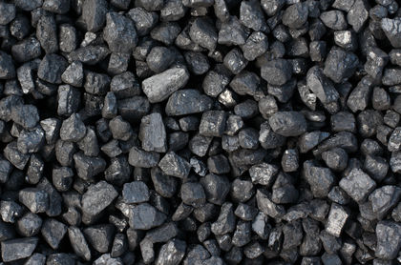
What do you think is this?

Slide 53
Group 4a
The Group is composed of metals, metalloids, and nonmetals, therefore the electronegative does not follow the normal trend
Carbon~ nonmetal Silicon~ metalloid Germanium~ metalloid Tin~ metal Lead~metal

Slide 54
Isotopes of the Element Carbon
Mass Number Natural Abundance Half-life
12 98.93% Stable
13 1.07% Stable
14 5700 years
Carbon 14 is use to detect when a living thing has died, i.e carbon dating

Slide 55
Occurrence of Carbon
Carbon is an extraordinary element. It occurs in more different forms than any other element in the periodic table.
More than ten million compounds of carbon are known. No other element, except for hydrogen, occurs in even a fraction of that number of compounds.
As an element, carbon occurs in a striking variety of forms. Coal, soot, and diamonds are all nearly pure forms of carbon. Carbon also occurs in a form, discovered only recently, known as fullerenes
Fullerene carbon holds the promise for opening a whole new field of chemistry
Carbon occurs extensively in all living organisms as proteins, fats, carbohydrates (sugars and starches), and nucleic acids.

Slide 56
Allotropes of Carbon
Carbon exists in a number of allotropic forms (Allotropes are forms of an element with different physical and chemical properties)
E.g. are diamond and graphite which have crystalline structures (In a crystalline material, atoms are arranged in a neat orderly pattern)
Graphite is found in pencil "lead" and ball-bearing lubricants
Example of non-crystalline allotropes of carbon are coal, lampblack, charcoal, carbon black, and coke
Carbon black is similar to soot
Coke is nearly pure carbon formed when coal is heated in the absence of air
These Carbon allotropes that lack crystalline structure are amorphous, or without crystalline shape
(Elemental Forms of Carbon: Graphite, Diamond, Coke, and Carbon Black)

Slide 57
Allotropes of Carbon
The allotropes of carbon have very different chemical and physical properties
For example, diamond is the hardest natural substance known. It has a rating of 10 on the Mohs scale (The Mohs scale is a way of expressing the hardness of a material, It runs from 0 (for talc) to 10 (for diamond)
M.P. for Diamond is 3,700°C (6,700°F) and its B.P. is about 4,200°C (7,600°F)
Its density is 3.514 g/cm³)

Slide 58
Allotropes of Carbon
On the other hand, graphite is a very soft material. It is often used as the "lead" in lead pencils. It has a hardness of 2.0 to 2.5 on the Mohs scale
Graphite does not melt when heated, but sublimes at about 3,650°C (6.600°F)
Its density is 2.26 g/cm³ . The numerical value for these properties varies depending on where the graphite originates
The amorphous forms of carbon, like other non-crystalline materials, do not have clear-cut melting and boiling points
Their densities vary depending on where they originate

Slide 59
Comparing Diamond and Graphite
Diamond (3.514 g/cm³) is much denser than graphite (2.26 g/cm³)
Whereas diamond is the hardest substance known, graphite is one of the softest
Diamond is an excellent insulator, with little or no tendency to carry an electric current
Graphite is such a good conductor of electricity that graphite electrodes are used in electrical cells.

Slide 60
Comparing Diamond and Graphite
Graphite is the most stable form of carbon at 25ºC and 1 atm pressure
At very high temperatures and pressures, diamond becomes more stable than graphite

Slide 61
Chemical Properties of Carbon
The chemistry of carbon is dominated by three factors.
1. Carbon forms unusually strong C-C single bonds, C=C double bonds, and carbon-carbon triple bonds.
2. The electronegativity of carbon (EN = 2.55) is too small to allow carbon to form C⁴⁻ ions with most metals and too large for carbon to form C⁴⁺ ions when it reacts with nonmetals. Carbon therefore forms covalent bonds with many other elements, mainly tetravalent
3. Carbon forms strong double and triple bonds with a number of other nonmetals, including N, O, P, and S

Slide 62
Chemistry of Carbon
Although carbon is essentially inert at room temperature, it reacts with less electronegative negative elements at high temperatures to form compounds known as carbides
When carbon reacts with an element of similar size and electronegativity, a covalent carbide is produced
Silicon carbide, for example, is made by treating silicon dioxide from quartz with an excess of carbon in an electric furnace at 2300 K.
SiO₂(s)+3 C(s) → SiC(s)+2 CO(g)

Slide 63
Chemistry of Carbon
Compounds that contain carbon and one of the more active metals are called ionic carbides.
E.g. CaO(s)+3 C(s) → CaC₂(s)+CO(g)
Carbides normally burst into flame when added to water. This is because the ionic carbides that formally contain the C⁴⁻ ion react with water to form methane, which is ignited by the heat given off in this reaction.
C⁴⁻+4 H₂O → CH₄+4 OH⁻
The ionic carbides that formally contain the C₂²⁻ ion react with water to form acetylene, which is ignited by the heat of reaction.
C₂²⁻+2 H₂O → C₂H₂+2 OH⁻

Slide 64
Some Compounds of Carbon
A carborane is a cluster composed of boron and carbon atoms such as H₂C₂B₁₀H₁₀
Important inorganic carbon-sulfur compounds are the carbon sulfides , carbon disulfide (CS₂) and carbonyl sulfide (OCS)
Another compound is Carbon monosulfide (CS) , unlike carbon monoxide is very unstable
Other compound classes are thiocarbonates, dithiocarbamates and trithiocarbonates

Slide 65
Some compounds of Carbon
The common carbon halides are carbon tetrafluoride (CF₄), carbon tetrachloride (CCl₄), carbon tetrabromide (CBr₄), carbon tetraiodide (CI₄), and a large number of other carbon-halogen compounds.

Slide 66
Carbide
Aluminum carbide is prepared by direct reaction of aluminum and carbon in an electric arc furnace
4 Al + 3 C → Al₄C₃
An alternative reaction begins with alumina, but it is less favorable because of generation of carbon monoxide
2 Al₂O₃ + 9 C → Al₄C₃ + 6 CO
Boron carbide was first synthesized by reduction of boron trioxide either with carbon or magnesium in presence of carbon in an electric arc furnace
In the case of carbon, the reaction occurs at temperatures above the melting point of B₄C
2 B₂O₃ + 7 C → B₄C + 6 CO

Slide 67
The Oxides of Carbon
Although the different forms of carbon are essentially inert at room temperature, they combine with oxygen at high temperatures to produce a mixture of carbon monoxide and carbon dioxide e.g.
2 C(s)+O₂(g)2 → 2CO(g) ∆ Hº = -110.52 kJ/mol CO
C(s)+O₂(g) → CO₂(g) ∆ Hº = -393.51 kJ/mol CO₂
CO can also be obtained when red-hot carbon is treated with steam.
C(s)+H₂O(g) → CO(g)+H₂(g)

Slide 68
Fullerenes
C₆₀ form of pure carbon is named fullerenes after the inventor R. Buckminster Fuller, C₆₀ was named buckminsterfullerene, or "buckyball" for short
C₆₀ is now known to be a member of a family of compounds known as the fullerenes. Other compounds in this family include C₃₂, C₄₄, C₅₀, C₅₈, and C₇₀

Slide 69
Silicon
Silicon, the second most abundant element on earth, is an essential part of the mineral world
It's stable tetrahedral configuration makes it incredibly versatile and is used in various way in our every day lives
Found in everything from spaceships to synthetic body parts, silicon can be found all around us, and sometimes even in us
The most common compound of silicon, is the most abundant chemical compound in the earth's crust, which we know it better as common beach sand

Slide 70
Properties of Silicon
Silicon is a crystalline semi-metal or metalloid
One of its forms is shiny, grey and very brittle (it will shatter when struck with a hammer)
It is a group 4a element in the same periodic group as carbon, but chemically behaves distinctly from all of its group counterparts
Silicon shares the bonding versatility of carbon, with its four valence electrons, but is otherwise a relatively inert element
However, under special conditions, silicon can be made to be a good deal more reactive
Silicon exhibits metalloid properties, is able to expand its valence shell, and is able to be transformed into a semiconductor; distinguishing it from its periodic group members

Slide 71
Properties of Silicon
Density is 2.57 g/mL
M.P. 1414ºC
B. P. 3265ºC
Stable Isotopes ²⁸Si ²⁹Si ³⁰Si
Oxidation States 4+, 3+, 2+, 1+, -1, -2, -3, -4
27.6% of the Earth's crust is made up of silicon

Slide 72
Silicon Compounds
Silicon forms a series of compounds analogous to the alkanes, e.g. silanes, but the longest chain contains just seven Si stoms i.e heptasilane, Si7 H16
The Silanes are less volatile than their hydrocarbon analogues, e.g. C3H8 is a gas whileSi3H8 Trisilane is a liquid that boils at 53oc.
Silicon has a high affinity for oxygen, accounting for the high amount of silicates minerals known
Example is silicate glasses such as fused qurtz amorphous SiO2

Slide 73
Silicon Compounds: Silicides
This is Silicon-metal compounds
Silicon like B and C form wide variety of binary compounds with metals e.g. ferrosilicon (Fe3Si)

Slide 74
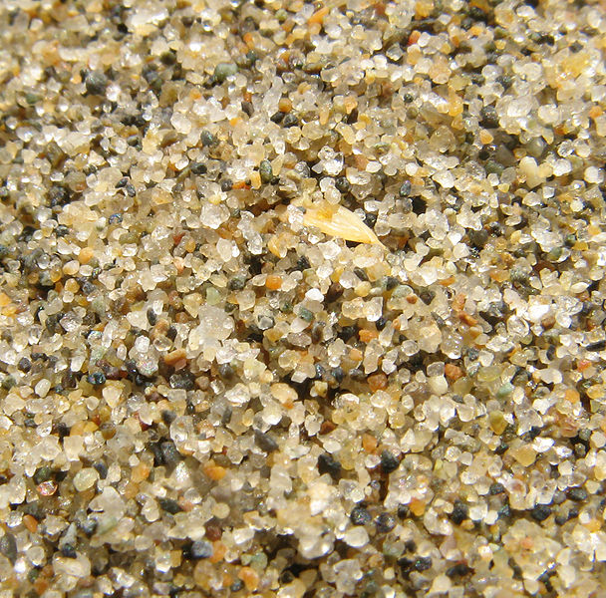
Silicon

Slide 75
Group V and Group VI Elements
AS in the other p-block elements, elements at the head of the groups V and VI differ significantly from their congeners
Their coordination numbers are generally lower in their compounds and they are the only members of their groups that exist as diatomic molecules under normal conditions
The group V elements posses a wide range of oxidation states

Slide 76
Group V and Group VI Elements
This two groups contain some of the most important elements for geology, life and industry.
The heavier elements are less abundant than the lighter elements
All the members of this two groups other than Nitrogen and Oxygen are solids under normal conditions
Metallic character increases down the group, but the trend is not clear cut because the electrical conductivities of the heavier elements actually decrease from arsenic to bismuth

Slide 77
Group V and Group VI Elements
Nitrogen and Oxygen are among the most electronegative elements in the periodic table.

Slide 78
Group V and Group VI Elements Properties of the groups (5)
ELEMENTS | Ionization energy (Kjmol ⁻¹ | Radius A º | Appearance | Common oxidation state
N | 1410 | 3.04 | Gas | -3, 0, +1,+3, +5
P | 1020 |  | Polymorphic solid | -3, +3, +5
As | 953 |  | Dark solid | +3, +5
Sb | 840 |  | Solid, metallic luster, brittle | +3, +5
Bi | 710 |  | Solid, metallic luster, brittle | +3, +5

Slide 79
Group V and Group VI Elements Properties of the groups (6)
Elements | Ionization energy(Kjmol-1) | Radius | Appearance | Common oxidation state
O | 1320 | 3.44 | Paramagnetic, gas | -2, -1,0
S | 1005 | 2.44 | Yellow, Polymorphic solid | -2, 0, +4, +6
Se | 947 | 2.55 | Polymorphic solid | _2, +4, +6
Te | 875 | 2.10 | Solid, silver, brittle | -2, +4, +6
Po |  |  | Solid all isotopes radioactive | -2, +2, +4, +6

Slide 80
Properties of Group V
Elements Electronegativity Electro Affinity
N 3.066 -7
P 2.053 72
As 2.211 78
Sb 1.984 103
Bi 2.01 91

Slide 81
The Chemistry of Nitrogen
Nitrogen forms a diatomic molecule with a Nitrogen-Nitrogen triple bond with unusual stability
The molecule has low reactivity due to this stable bond, so almost inert
Liquid Nitrogen is used in many chemical reactions to provide inert environment or in liquid form as a coolant

Slide 82
The Chemistry of Nitrogen
In addition to ammonia, nitrogen forms some hydrides N2H4 also known as hydrazine, N2H2 known as diazene and HN3 i.e. hydrazoic acid
Ammonia and ammonium ion have a very vast chemistry, ammonia is very important for industries, about 80% is used in fertilizer
It is also used in the synthesis of explosives, synthetic fibers such as rayon, nylon and polyurethanes
It is also used in the synthesis of a wide variety of organic and inorganic compounds
Industrially , NH3 is synthesized from it elements by Haber process
N2 + 3H2 → NH3 using finely divided iron as catalyst, temp above 380 ^{oc} and pressure of about 200atm

Slide 83
Chemistry of Nitrogen
Nitrogen form many compounds with oxygen i.e. oxides
Examples are N2O Nitrous Oxide, NO, Nitric Oxide, NO2 Nitrogen dioxide, N2O3 Dinitrogen trioxide, N2O4 Dinitrogen tetroxide and N2O5 Dinitrogen pentoxide

Slide 84
Phosphorus
Phosphorus has many allotropes, the most common of them is white phosphorus, α-P4 which is cubic in shape and β-P4 which is hexagonal in shape
Heating white phosphorus in the absence of air gives red phosphorus
Another allotrope is black phosphorus which is the most thermodynamically stable form
Phosphorus exist also as tetrahedral P4 molecules in the liquid and gas phase

Slide 85
Group VII a
All known as the halogens, i.e salt givers
All the elements are non metals
The Oxoanions are oxidizing agents
Their reactions are fast
F and Cl are poisonous gases
Br is a toxic volatile liquid
I is a sublimable solid
Their chemical properties are extensive
F has a lower electron affinity than Cl but high electronegativity
The halogens are so reactive that they are found naturally only as compounds

Slide 86
Electronegativity of group VIIa
Electronegativity is a measure of the tendency of an atom to attract a bonding pair of electrons. It falls as you go down Group 7. In any covalent bond involving a halogen, the bonding pair feels a net pull of 7+ from the halogen nucleus – the charge on the nucleus minus the number of inner, screening electrons. But because of the extra layers of electrons, the bonding pair gets further from the nucleus as you go down the group, and so the effect of the attraction gets less. So by definition, the electronegativity decreases as you go down group 7a

Slide 87
Group VIIa
Solubility of group VII elements in water and Hexane
They are soluble in hexane and not water because hexane like the halogens only has van der Waals dispersion forces between its molecules. That means that the attractions that need to be broken in the halogen and in the hexane can be replaced by similarly sized attractions between halogen and hexane molecules. That isn't true in water, where stronger hydrogen bonds in the water have to be broken as well, but no similar attractions can be set up between halogen and water molecules.

